Slide 1

CAPSTONE PROJECT - 3 Mobile Price Range Prediction Classification project
PRESENTED BY:
Aman Sharma
Mattaparty Harish
Pratik Thorat
1

Slide 2
Introduction :
In the competitive mobile phone market companies want to understand sales data of mobile phones and factors which drive the prices, our objective is to find out some relation between features of a mobile phone(eg:- RAM, Internal Memory, etc.) and its selling price. In this problem, we do not have to predict the actual price but a price range indicating how high the price is.

Slide 3
Timeline:
1.
3.
PROBLEM OVERVIEW
OUTLIERS HANDLING &
DATA MANUPULATION
2.
4.
DATASET DESCRIPTION
EXPLORATORY DATA ANALYSIS & CONCLUSION

Slide 4
Timeline Continued..
5.
7.
HYPOTHESIS TESTING AND CONCLUSION
ML MODEL IMPLIMENTATION & CONCLUSION
6.
8.
FEATURE SELECTION, TRANSFORMATION & DATA SCALING
MODEL DEPLOYMENT

Slide 5
PROBLEM OVERVIEW:
Mobile Price Range Prediction data is a data set containing information regarding RAM, Camera, Mobile Weight, Price Range of different phones.
Using the data given we had to build a model for predicting the price range of a mobile phone.
To build a machine learning model, we first perform EDA with various plots for better visualization.
And then we split it into training & testing dataset and applied various machine learning algorithms on the training data to train the model. Finally, we evaluated the model's performance on the test data to check how well it predicted the results.
Based on the metrics, we choose the best model & applied it in the deployment part.

Slide 6
DATASET DESCRIPTION:
Source dataset is in csv format.
Dataset contains 2000 rows and 21 columns.
All the columns are in numerical format.
There are no missing and duplicate values found from the provided dataset.
Only blue, dual_sim, four_g, three_g, touch_screen, wifi column has Boolean values, which indicates weather the phone has following feature or not.
Feature named price_range is dependent variable and rest are independent variables.

Slide 7
VARIABLES DESCRIPTION :
Battery_power - Battery capacity in mAh.
Blue - Has bluetooth or not.
Clock_speed - speed at which microprocessor executes instructions.
Dual_sim - Has dual sim support or not.
Fc - Front Camera Megapixels.
Four_g - Has 4G or not.
Int_memory - Internal Memory capacity.
M_dep - Mobile Depth in cm.
Mobile_wt - Weight of mobile phone.
N_cores - Number of cores in processor.
Pc - Primary Camera Megapixels.
Px_heigh - Pixel Resolution Height.
Px_width - Pixel Resolution Width.
Ram - Random Access Memory in MB.
Touch_screen - Has touch screen or not.
Wifi - Has wifi or not.
Sc_h - Screen Height in cm.
Sc_w - Screen Width in cm.
Talk_time - Longest time that a single. battery charge will last over a call.
Three_g - Has 3G or not.
Price_range - This is the target variable. with value of 0 (low cost), 1 (medium cost), 2 (high cost) and 3 (very high cost).

Slide 8
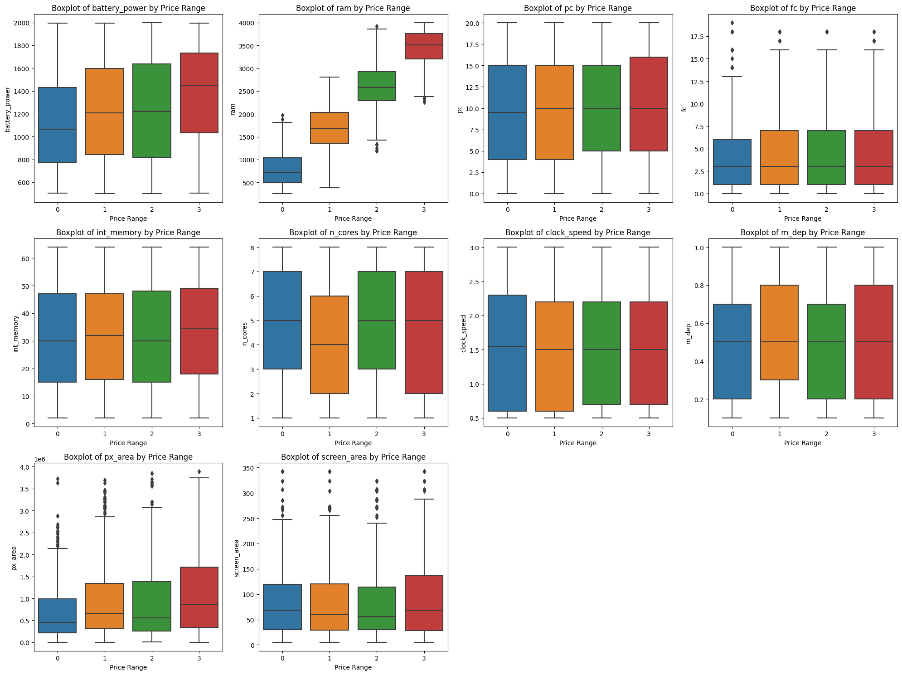
CHECKING FOR OUTLIERS:

Slide 9
OUTLIERS TREATMENT:
We have found 2 values in 'Pixel_height' are 0 which are outliers, so we replaced it with mean value.
We have found 180 values in 'Screen_width' are 0 which are outliers, so we replaced it with mean value.
Rest of the outliers in the numerical variables are ignored due to less observations in the dataset.

Slide 10
DATA MANIPULATION:
We have created a new feature 'Pixel_area' by multiplying 'Pixel_height' & 'Pixel_width'.
We have created a new feature 'Screen_area' by multiplying 'Screen_height' & 'Screen_width'.
We have created new features for front & primary cam for indicating presence of camera by taking all the values above 0 as 1.
We have created 4 ram bins ranging from 1GB to 4GB to check the distribution of ram in different price range.

Slide 11
EXPLORATORY DATA ANALYSIS

Slide 12
UNIVARIATE ANALYSIS

Slide 13
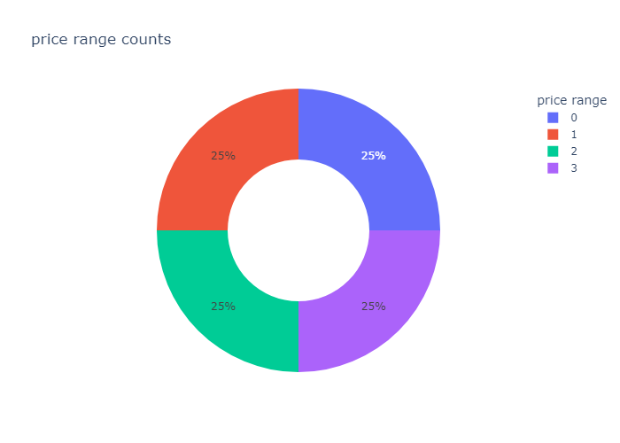
PHONE DISTRIBUTION ON THE BASIS OF PRICE RANGE :
Mobile phones in all 4 types of price range are equally distributed. Which indicate data set is completely balanced, so implementation of balancing techniques are not required.

Slide 14
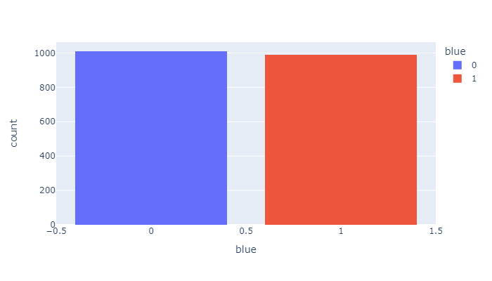
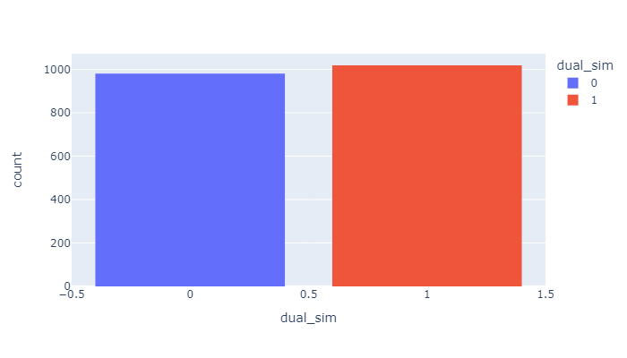
BLUETOOTH AND DUAL SIM AVAILABILITY:
Almost 50% phones are having Bluetooth connectivity.
Almost 50% phones are having dual sim.

Slide 15
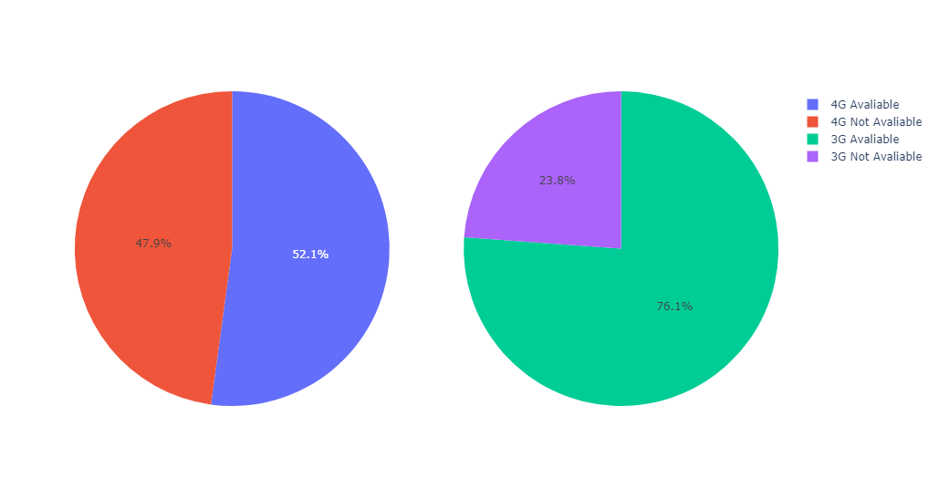
4G AND 3G AVAILABILITY :
Almost 48% phones lack 4G connectivity and 23% phones lack 3G connectivity.
Phones lacking 3G are not having 4G connectivity as well.
15

Slide 16
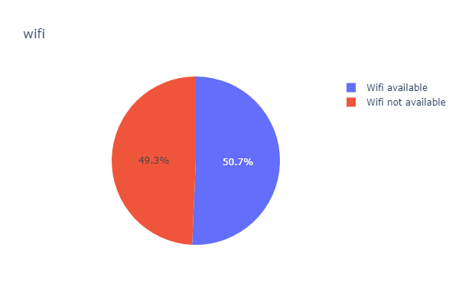
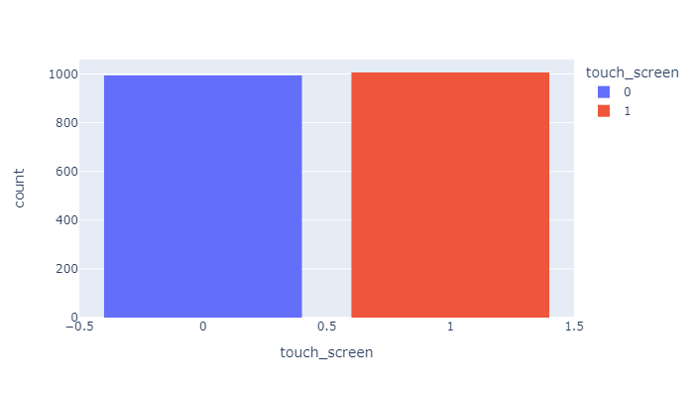
TOUCH SCREEN AND WIFI AVAILABILITY:
Almost 50% phones does not touch screen.
Almost 50% phones lack wifi connectivity.

Slide 17
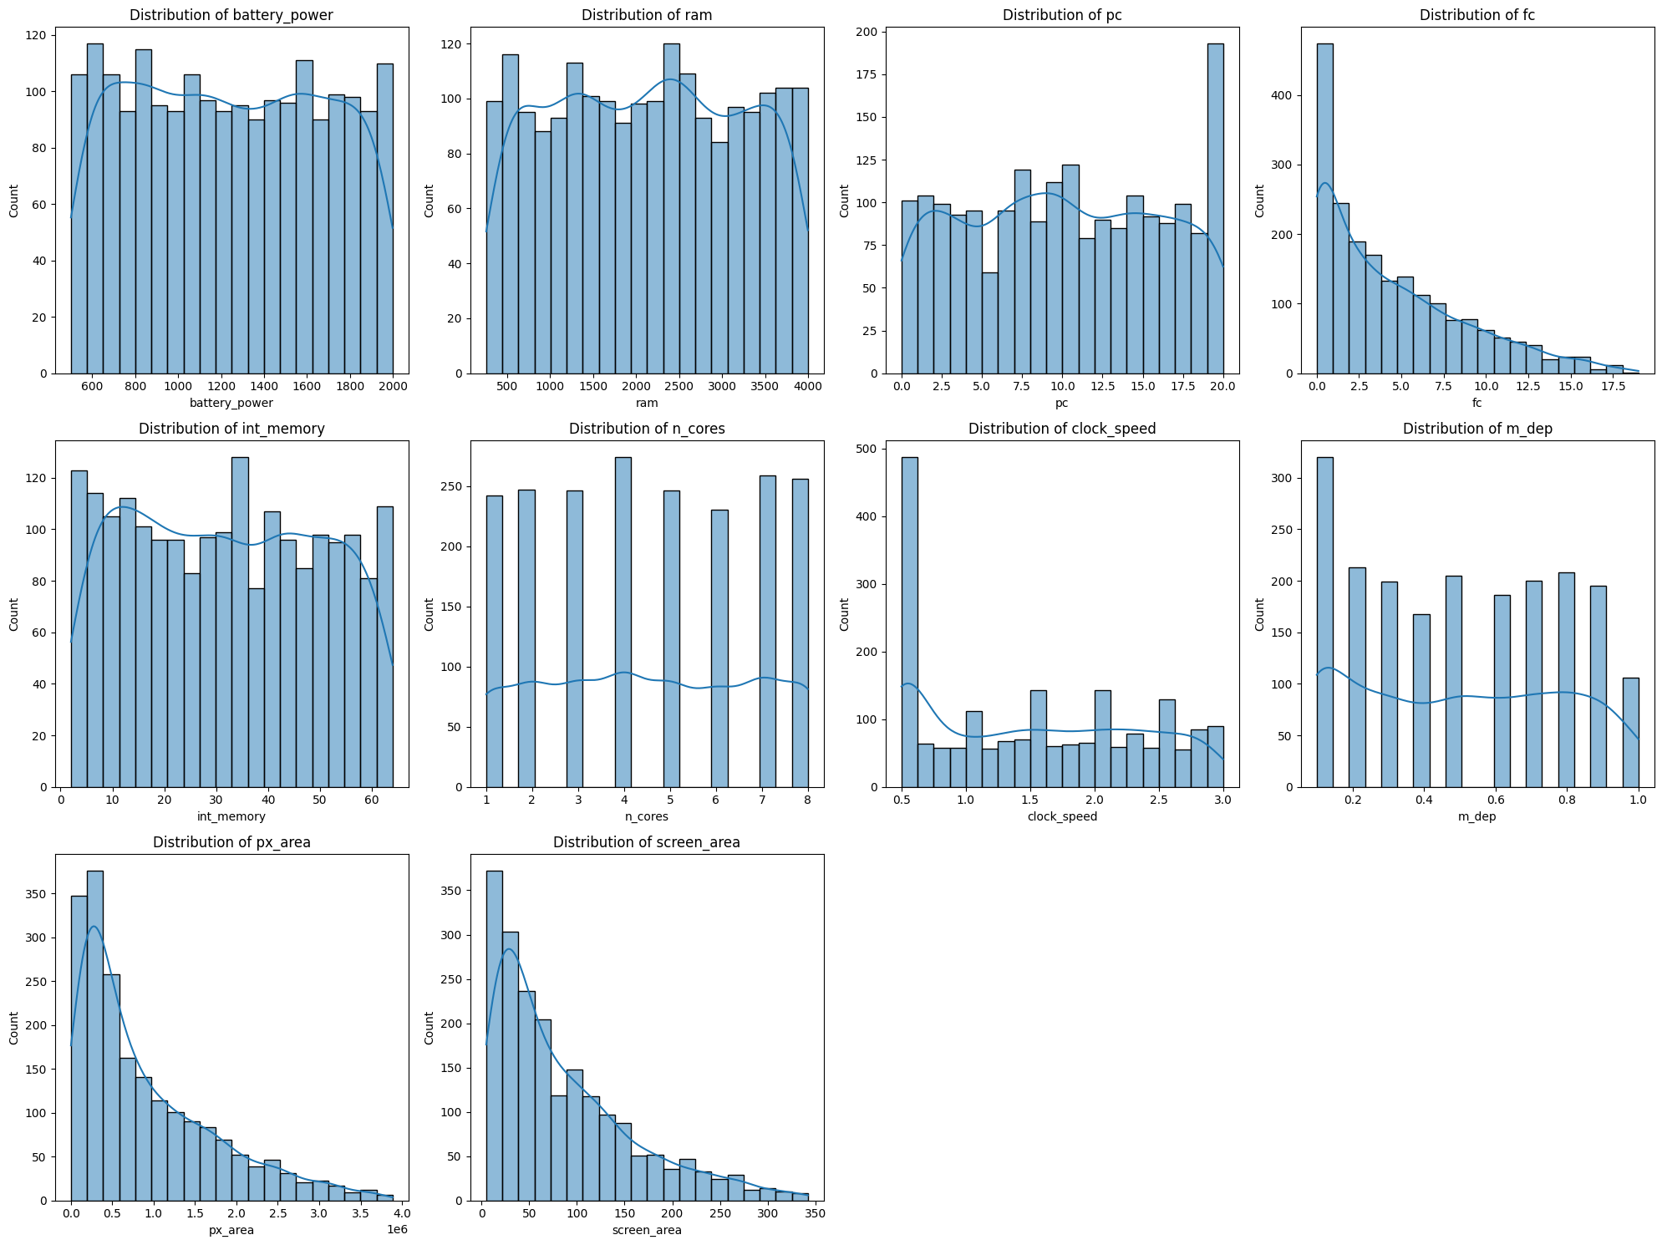
DISTRIBUTION OF VARIABLES:
Distribution of data in 'Screen Area', 'Pixel Area' & 'Front cam' is positively skewed.
17

Slide 18
BIVARIATE ANALYSIS

Slide 19
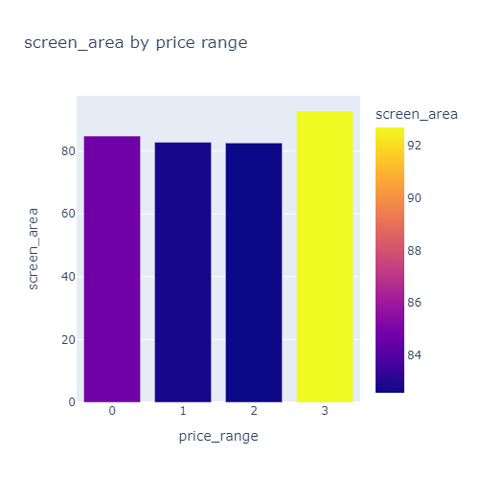
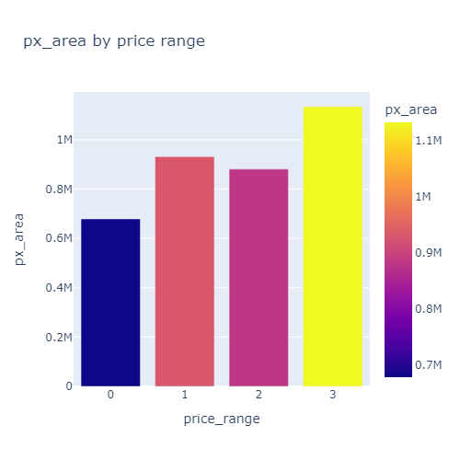
SCREEN AREA AND PX AREA BY PRICE RANGE:
Higher price phones have larger screen & larger pixels resulting in better screen quality.

Slide 20
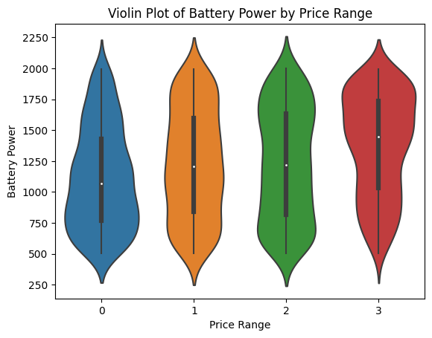
BATTERY POWER BY PRICE RANGE:
Prices are directly proportional to the Battery Power provided in the phones.
Lower range phones have battery power in 500 to 1000 range and for very high range have between 1500 to 2000.
17

Slide 21
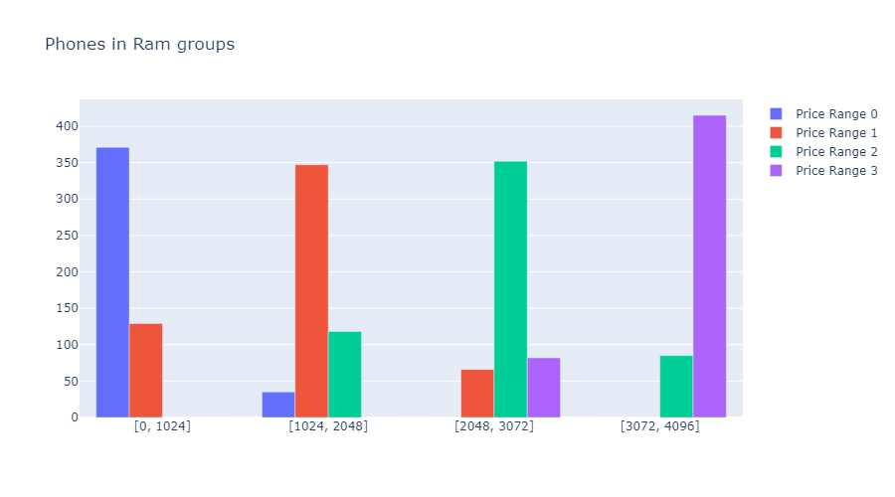
RAM DISTRIBUTION BY PRICE RANGES:
Lower price range phones mostly fall under 1GB RAM bin.
Higher price range phones mostly fall under 3GB to 4GB RAM bin.
21

Slide 22
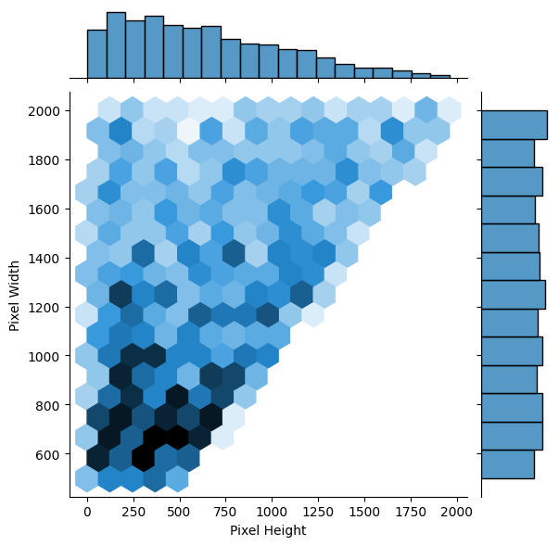
PIXEL WIDTH VS PIXEL HEIGHT:
Maximum phones have pixels in between 600×150 - 1000×750 range.

Slide 23
MULTIVARIATE ANALYSIS

Slide 24
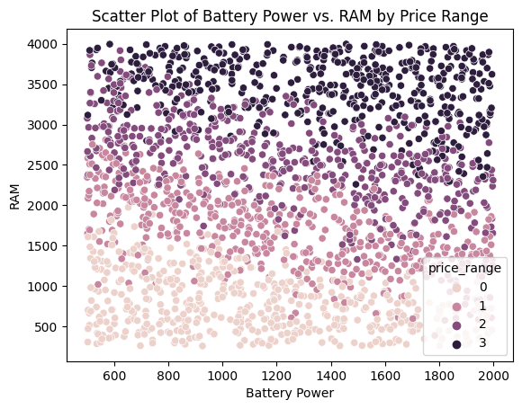
BATTERY POWER VS. RAM BY PRICE RANGE:
There is correlation between Higher battery and ram memory with expensive and very expensive phones.
Lower battery and ram memory is correlated with low and medium range phones.

Slide 25
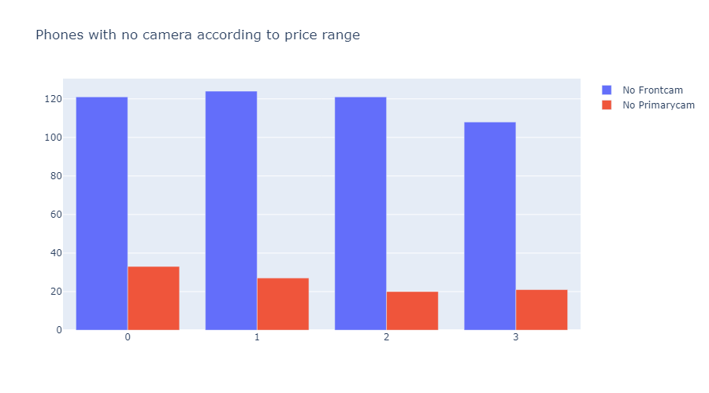
FRONT AND PRIMARY CAM AVAILABILITY IN PRICE RANGE:
There are more phones with no front cam than no primary cam through all price ranges.
Phones which are not having primary cam are also not having front cam.

Slide 26
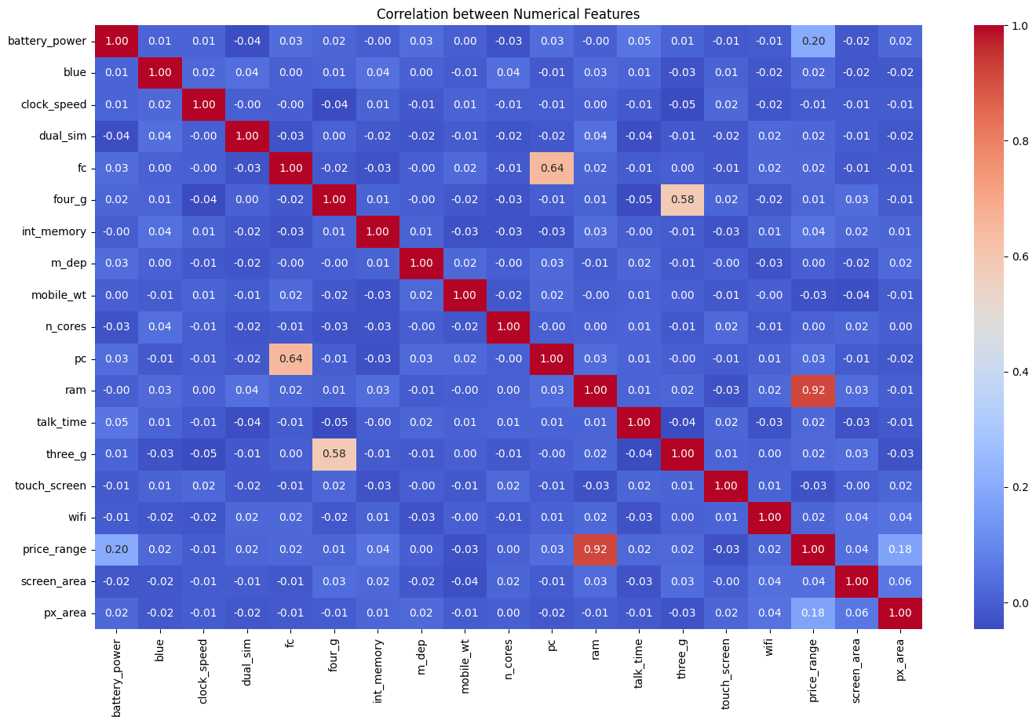
HEAT MAP:
RAM & Price range are highly correlated with each other.
Primary cam & Front cam are highly correlated with each other.
four_g and three_g are corelated with each other.
26

Slide 27
CONCLUSIONS FROM EDA:
Phones which are not having 3G don't have 4G connectivity as well.
Phones which are not having Primary cam don't have front cam as well.
Low price phones mostly fall under Rambin 1GB & very high cost phones fall under ram-bin of 3GB to 4GB.
Adequate amount of ram should be provided in lower range phones too for stabilized performance of phone which can effect the brand image in a positive way.
Very high cost phones have larger screen area & pixel area as well, resulting in better screen quality.
Very high cost phones have larger battery size & mobile weight is lowest.
There are many phones with no front cam through out all price ranges, at least it should be present in all very high cost phones.

Slide 28
HYPOTHESIS TESTING :
Internal memory, Ram is normally distributed so we have applied 2 sample T-Test to check if there is significant difference with respect to price range.
Screen area column is not normally distributed so can not use population variable that’s way we have applied Mann-Whitney U Test to check if there is significant difference with respect to price range.
Mobile 4G connectivity is categorical Hence we have used chi-square test to check dependency with price range.

Slide 29
CONCLUSIONS FROM HYPOTHESIS TESTING :
There is significant difference in the mobile price range with respect to average ram .
There is significant difference in mobile price range with respect to average int_memory.
There is significant dependency between the mobile price range and 4G connectivity.
There is significant difference in price range with respect to screen area.

Slide 30
FEATURE ENGINEERING & SELECTION

Slide 31
FEATURE ENGINEERING & SELECTION :
FEATURE SELECTION :
We have used sklearn.feature_selection module for feature selection/dimensionality reduction on dataset, to improve estimators accuracy scores and to boost their performance on very high-dimensional datasets.
We have checked p-value for all independent variables and removed features which are having confidence interval below 90%.
Sr.no. | input_variable | p_value | f_score
1 | screen_area | 0.10 | 2.12
2 | n_cores | 0.05 | 2.63
3 | int_memory | 0.03 | 2.92
4 | mobile_wt | 0.01 | 3.59
5 | px_area | 0.00 | 26.36
6 | battery_power | 0.00 | 31.60
7 | ram | 0.00 | 3520.11

Slide 32
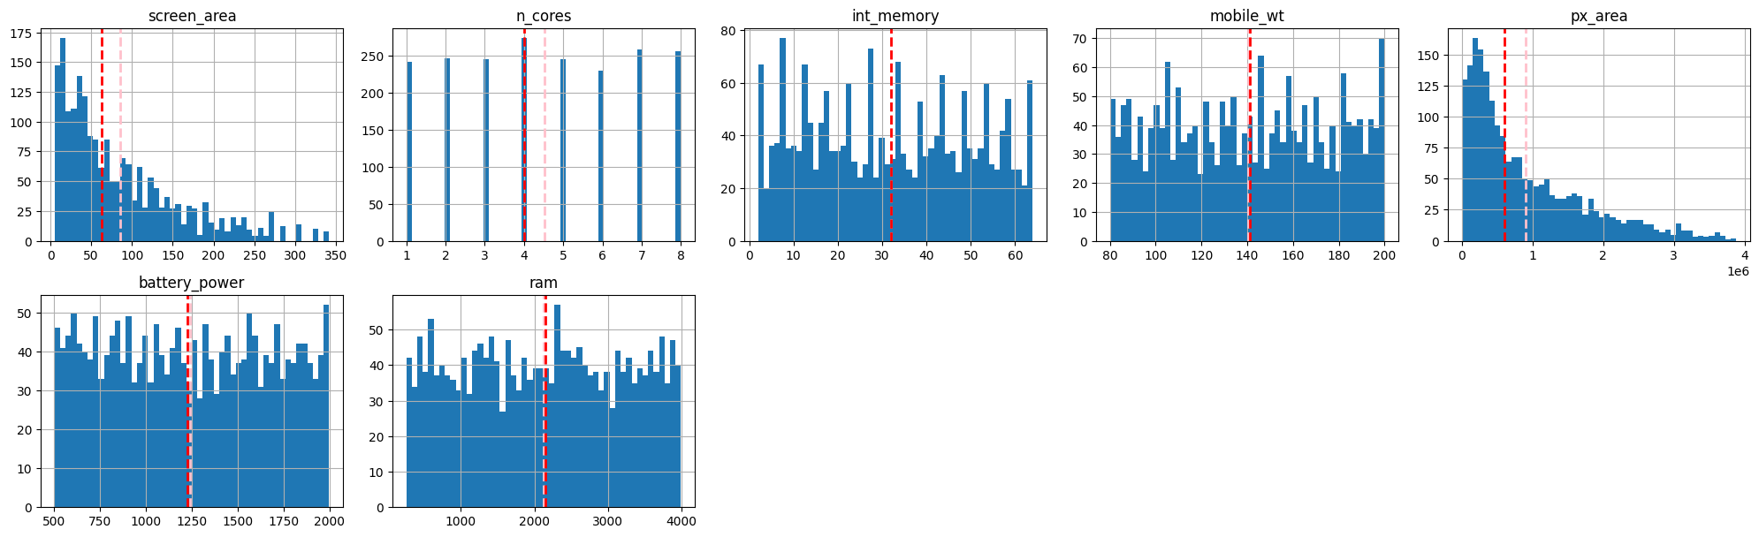
DATA TRANSFORMATION:
COLUMNS BEFORE APPLYING POWER TRANSFORMER:

Slide 33
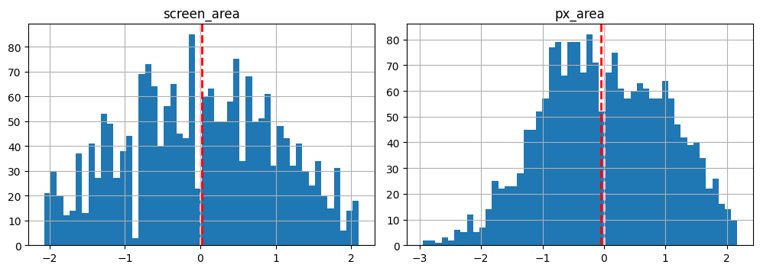
DATA TRANSFORMATION:
FEATURES AFTER APPLYING POWER TRANSFORMER:

Slide 34
DATA SCALING:
StandardScaler is used to resize the distribution of values ​​so that the mean of the observed values ​​is 0 and the standard deviation is 1
Data after applying standard scaler:
 | screen_area | n_cores | int_memory | mobile_wt | px_area | battery_power | ram
0 | 0.02 | -1.10 | -1.38 | 1.35 | -2.24 | -0.90 | 0.39
1 | -0.20 | -0.66 | 1.16 | -0.12 | 1.12 | -0.50 | 0.47
2 | -0.99 | 0.21 | 0.49 | 0.13 | 1.36 | -1.54 | 0.44
3 | 0.82 | 0.65 | -1.22 | -0.26 | 1.36 | -1.42 | 0.59

Slide 35
ML MODEL IMPLEMENTATION:
ML Models used for training & testing:
Logistic Regression
KNN Classifier
Random Forest Classifier
XG Boost Classifier
Light GBM Classifier
CatBoost Classifier
SVM Classifier

Slide 36
MODEL EVALUTION METRICS & MODEL SELECTION:
 | Accuracy | Precision | Recall | F1 score
Logistic Regression | 0.94 | 0.95 | 0.94 | 0.94
Tuned L. R. | 0.94 | 0.95 | 0.95 | 0.95
Auto ML L. R. | 0.95 | 0.95 | 0.95 | 0.95
KNN | 0.77 | 0.78 | 0.77 | 0.77
Tuned KNN | 0.78 | 0.79 | 0.78 | 0.78
Random Forest | 0.91 | 0.91 | 0.91 | 0.91
Tuned R. F. | 0.89 | 0.90 | 0.91 | 0.90
XGB | 0.92 | 0.92 | 0.92 | 0.92
Tuned XGB | 0.89 | 0.90 | 0.90 | 0.90
LGBM | 0.93 | 0.93 | 0.93 | 0.93
Tuned LGBM | 0.89 | 0.93 | 0.93 | 0.93
Cat Boost | 0.94 | 0.95 | 0.94 | 0.94
Tuned Cat Boost | 0.90 | 0.91 | 0.92 | 0.91
SVM | 0.92 | 0.92 | 0.92 | 0.92
Tuned SVM | 0.94 | 0.95 | 0.95 | 0.95
ML Model selected for deployment:
Based on the overall metrics we have selected logistic regression as our best model.
Logistic Regression is a “Supervised machine learning” algorithm that can be used to model the probability of a certain class or event.
Although it is said Logistic regression is used for Binary Classification, it can be extended to solve multiclass classification problems as well.

Slide 37
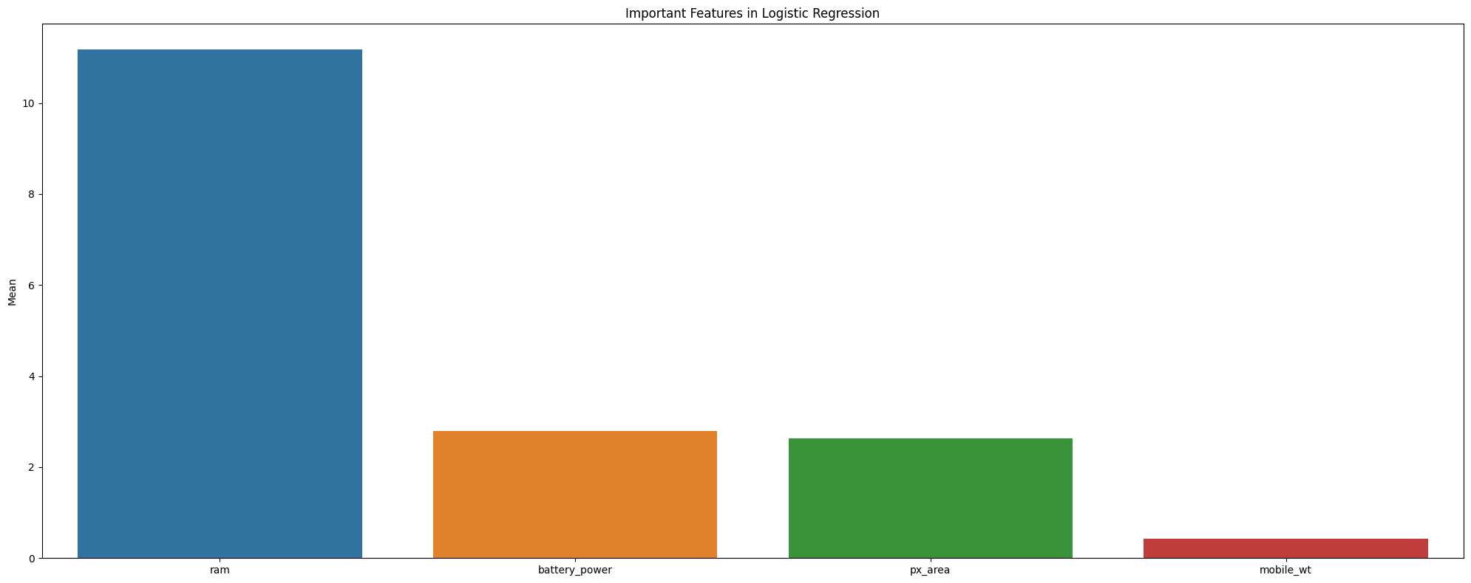
FEATURES IMPORTANCE IN LOGISTIC REGRESSION:
Since logistic regression is white box model we have selected important features based on the coefficient of variables.
Ram is most important feature in our model.

Slide 38
CONCLUSIONS FROM MODEL:
Simple and easy to implement: Logistic regression is a relatively simple statistical method that does not require much mathematical or statistical knowledge to use.
Works well with small datasets: Logistic regression can work well with small datasets, which is often the case in many practical applications.
Interpretable results: Logistic regression provides coefficients for each independent variable that can be interpreted as the change in the log odds of the dependent variable for a one-unit change in the independent variable.
Can handle both categorical and continuous variables: Logistic regression can handle both categorical and continuous independent variables, making it a versatile method for modeling binary outcomes.

Slide 39
Limitations:
Assumes linearity: Logistic regression assumes a linear relationship between the independent variables and the log odds of the dependent variable. If this assumption is violated, the results may be inaccurate.
Sensitive to outliers: Logistic regression can be sensitive to outliers, which can have a significant impact on the results.
Suggestion:
When we are dealing with huge datasets & above disadvantages starts effecting the model, then using CatBoost Classifier can provide better results.

Slide 40
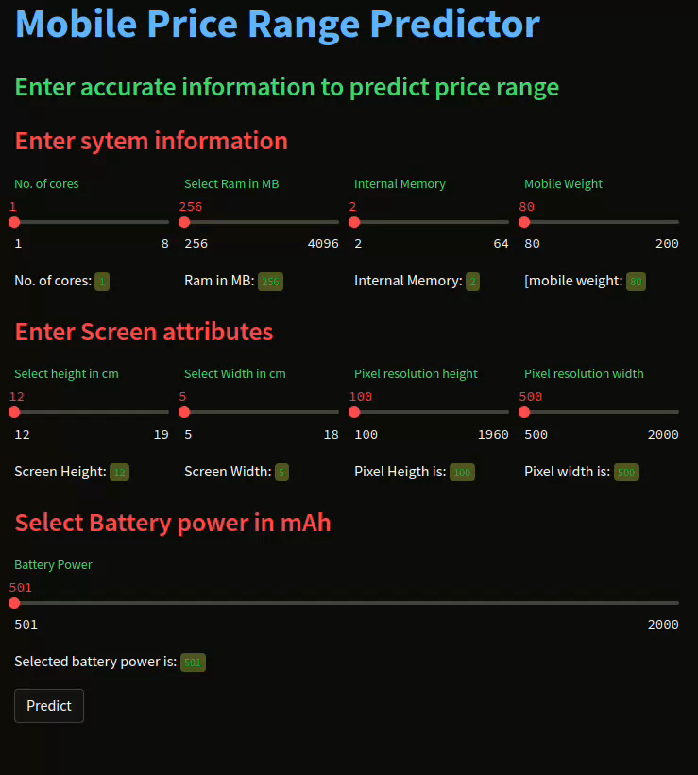
MODEL DEPLOYMENT :
40

Slide 41
THANK YOU
41

